Slide 1
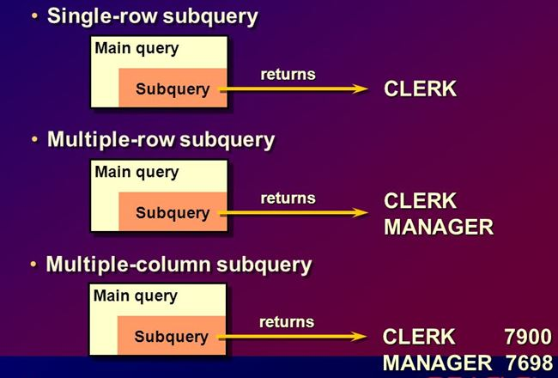

Slide 2
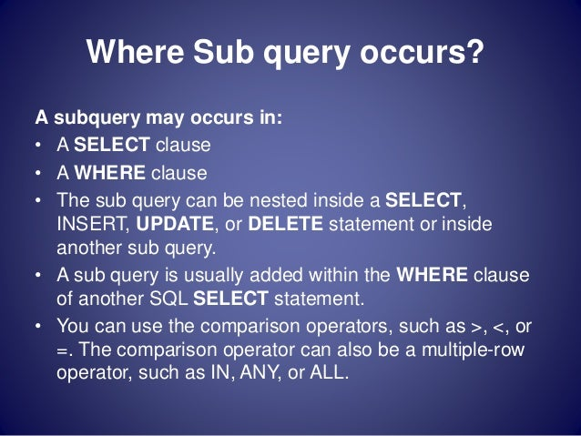

Slide 3
DEPT
DEPTNO | DNAME | LOC
10 | ACCOUNTING | NEW YORK
20 | RESEARCH | DALLAS
30 | SALES | CHICAGO
40 | OPERATIONS | BOSTON

Slide 4
EMP
EMPNO | ENAME | JOB | MGR | HIREDATE | SAL | COMM | DEPTNO
7839 | KING | PRESIDENT | - | 17-NOV-81 | 5000 | - | 10
8839 | Prince | MANAGER | 7839 | 17-NOV-81 | 3000 | - | 10
7698 | BLAKE | MANAGER | 7839 | 01-MAY-81 | 2850 | - | 30
7782 | CLARK | MANAGER | 7839 | 09-JUN-81 | 2450 | - | 10
8782 | PETER | MANAGER | 7782 | 09-JUN-81 | 2850 | - | 10
7566 | JONES | MANAGER | 7839 | 02-APR-81 | 2975 | - | 20
7788 | SCOTT | ANALYST | 7566 | 19-APR-87 | 3000 | - | 20
7902 | FORD | ANALYST | 7566 | 03-DEC-81 | 3000 | - | 20
7369 | SMITH | CLERK | 7902 | 17-DEC-80 | 800 | - | 20
7499 | ALLEN | SALESMAN | 7698 | 20-FEB-81 | 1600 | 300 | 30
7521 | WARD | SALESMAN | 7698 | 22-FEB-81 | 1250 | 500 | 30
7654 | MARTIN | SALESMAN | 7698 | 28-SEP-81 | 1250 | 1400 | 30
7844 | TURNER | SALESMAN | 7698 | 08-SEP-81 | 1500 | 0 | 30
7876 | ADAMS | CLERK | 7788 | 23-MAY-87 | 1100 | - | 20
9876 | MARTIN | ANALYST | 7788 | 23-MAY-87 | 2850 | - | 20
9976 | JOE | ANALYST | 7788 | 12-JAN-05 | 2000 | - | 20
7900 | JAMES | CLERK | 7698 | 03-DEC-81 | 950 | - | 30
7934 | MILLER | CLERK | 7782 | 23-JAN-82 | 1300 | - | 10
BACK

Slide 5
Single-row Sub-query
Display employees who are working in the ‘SALES’ department.
‘SALES’ is name of a department in the department table.
DEPTNO | DNAME | LOC
10 | ACCOUNTING | NEW YORK
20 | RESEARCH | DALLAS
30 | SALES | CHICAGO
40 | OPERATIONS | BOSTON
EMPNO | ENAME | JOB | MGR | HIREDATE | SAL | COMM | DEPTNO
7698 | BLAKE | MANAGER | 7839 | 01-MAY-81 | 2850 | - | 30
7499 | ALLEN | SALESMAN | 7698 | 20-FEB-81 | 1600 | 300 | 30
7521 | WARD | SALESMAN | 7698 | 22-FEB-81 | 1250 | 500 | 30
7654 | MARTIN | SALESMAN | 7698 | 28-SEP-81 | 1250 | 1400 | 30
7844 | TURNER | SALESMAN | 7698 | 08-SEP-81 | 1500 | 0 | 30
7900 | JAMES | CLERK | 7698 | 03-DEC-81 | 950 | - | 30

Slide 6
Single-row Sub-query
Display employees who are working in the ‘SALES’ department.
select * from emp
where deptno =
(select deptno from dept
where upper(dname) = ‘SALES’);
Inner query executed first
Returns one row and one value i.e. 30
EMPNO | ENAME | JOB | MGR | HIREDATE | SAL | COMM | DEPTNO
7698 | BLAKE | MANAGER | 7839 | 01-MAY-81 | 2850 | - | 30
7499 | ALLEN | SALESMAN | 7698 | 20-FEB-81 | 1600 | 300 | 30
7521 | WARD | SALESMAN | 7698 | 22-FEB-81 | 1250 | 500 | 30
7654 | MARTIN | SALESMAN | 7698 | 28-SEP-81 | 1250 | 1400 | 30
7844 | TURNER | SALESMAN | 7698 | 08-SEP-81 | 1500 | 0 | 30
7900 | JAMES | CLERK | 7698 | 03-DEC-81 | 950 | - | 30

Slide 7
Display the name(s) of the highest earning emp of dept no. 10.
select ename from emp
where deptno = 10
and sal =
(select max(sal)
from emp
where deptno = 10);

Slide 8
Single-row Sub-query
Display employees who have the same designation as that of employee 7698.
select * from emp
where job =
(select job from emp
where empno = 7698);
Inner query executed first
Returns one row and one value i.e. MANAGER
EMPNO | ENAME | JOB | MGR | HIREDATE | SAL | COMM | DEPTNO
8839 | Prince | MANAGER | 7839 | 17-NOV-81 | 3000 | - | 10
7698 | BLAKE | MANAGER | 7839 | 01-MAY-81 | 2850 | - | 30
7782 | CLARK | MANAGER | 7839 | 09-JUN-81 | 2450 | - | 10
8782 | PETER | MANAGER | 7782 | 09-JUN-81 | 2850 | - | 10
7566 | JONES | MANAGER | 7839 | 02-APR-81 | 2975 | - | 20

Slide 9
Single-row Sub-query
Display employees who have the same designation as that of employee 7698 and do not display empno 7698.
select * from emp
where empno <> 7698
and job =
(select job from emp
where empno = 7698);
EMPNO | ENAME | JOB | MGR | HIREDATE | SAL | COMM | DEPTNO
8839 | Prince | MANAGER | 7839 | 17-NOV-81 | 3000 | - | 10
7782 | CLARK | MANAGER | 7839 | 09-JUN-81 | 2450 | - | 10
8782 | PETER | MANAGER | 7782 | 09-JUN-81 | 2850 | - | 10
7566 | JONES | MANAGER | 7839 | 02-APR-81 | 2975 | - | 20

Slide 10
Multiple-row Sub-query
Display employees who are working at New York or Boston.
select * from emp
where deptno in
(select deptno from dept
where upper(loc) in (‘NEW YORK’, ‘BOSTON’));
Use ‘in’ operator as multiple values are getting selected
Display all those employees who have the same job as ALLEN, JAMES or BLAKE.
select * from emp
where job in
(select job from emp
where upper(ename) in (‘ALLEN’, ‘JAMES’, ‘BLAKE’));
DEPTNO
10
40

Slide 11
More examples…
Display details of employees who are earning more than BLAKE and have the same designation as JONES.
select * from emp
where sal > all
(select sal from emp where upper(ename) = 'BLAKE')
and upper(job) in
(select upper(job) from emp where upper(ename) = 'JONES');
** There could be more than one BLAKE and JONES
Display details of employees who are earning more than all employees of dept 30.
select * from emp
where sal > all
(select sal
from emp
where deptno = 30);
** ‘all’ is used as inner query select more than one value
OR
select * from emp
where sal >
(select max(sal)
from emp
where deptno = 30);

Slide 12
More examples…
Display details of employees who are earning more than at least one employee of dept 30.
select * from emp
where sal > any
(select sal
from emp
where deptno = 30);
IMP:
If inner query is going to fetch only one row / one value you can use any relational operator for comparison with outer query.
If inner query is going to fetch more than one row / value, along with the relational operator use all, any, in, some as required.
OR
select * from emp
where sal >
(select min(sal)
from emp
where deptno = 30);
Notes:
in, = any, = some would give similar output

Slide 13
One more aggregate function…
Display all designations of employees of dept 20.
select job from emp
where deptno = 20;
Some designations are repeated as more one than one
employee can have the same designation.
To display distinct values use the DISTINCT clause.
select distinct(job) from emp
where deptno = 20;
Can you execute the following?
select empno, ename, distinct(job) from emp
where deptno = 20;
NO!! (DISTINCT is an aggregate function)
JOB
MANAGER
ANALYST
ANALYST
CLERK
CLERK
ANALYST
ANALYST
JOB
MANAGER
ANALYST
CLERK

Slide 14
More examples…
Display details of employees who have the same designation as any designation of the department 20 employee.
select * from emp
where job = any
(select job
from emp
where deptno = 20);
Display details of employees who have the same designation as any designation of the RESEARCH department employee.
select * from emp
where job = any
(select job
from emp
where deptno in
(select deptno
from dept
where upper(dname) = ‘RESEARCH’));
Inner query level 1
Inner query level 2

Slide 15

More examples…
Display details of employees who have the same designation as any designation of the RESEARCH department employee.
select * from emp
where job = any
(select job
from emp
where deptno in
(select deptno
from emp
where upper(dname) = ‘RESEARCH’));
IMP:
At the same level Oracle allows 255 queries.
Oracle allows upto 16 levels of sub-queries.
fetches all jobs of deptno 20
fetches deptno 20

Slide 16
Quiz question…
Display the maximum salary for each dept.
select deptno, max(sal)
from emp
group by deptno;
DEPTNO | MAX(SAL)
30 | 2850
10 | 5000
20 | 3000
Display the names of the maximum earning employee(s) of each department.

Slide 17
Quiz question…
Display the maximum salary for each dept.
select deptno, max(sal)
from emp
group by deptno;
Display the names of the maximum earning employees of each department.
select ename, deptno, sal
from emp
where sal in
(select max(sal)
from emp
group by deptno);
The above query will give a wrong answer!!
DEPTNO | MAX(SAL)
30 | 2850
10 | 5000
20 | 3000
(2850, 5000, 3000)

Slide 18

Quiz question…
Display the names of the maximum earning employees of each department.
select ename, deptno, sal
from emp
where sal in
(select max(sal)
from emp
group by deptno);
(5000, 3000, 2850)
ENAME | DEPTNO | SAL
KING | 10 | 5000
Prince | 10 | 3000
BLAKE | 30 | 2850
PETER | 10 | 2850
SCOTT | 20 | 3000
FORD | 20 | 3000
MARTIN | 20 | 2850
This happened because only salary was compared and not the salary and deptno together.

Slide 19
Multiple-column subquery
Display the names of the maximum earning employees of each department.
select ename,deptno,sal
from emp
where (sal, deptno) in
(select max(sal), deptno
from emp
group by deptno);
5000 10
3000 20
2850 30
ENAME | DEPTNO | SAL
KING | 10 | 5000
BLAKE | 30 | 2850
SCOTT | 20 | 3000
FORD | 20 | 3000

Slide 20
Quiz question…
Display the names of the third highest earning employee(s).
select * from emp order by sal desc;
EMPNO | ENAME | JOB | MGR | HIREDATE | SAL | COMM | DEPTNO
7839 | KING | PRESIDENT | - | 17-NOV-81 | 5000 | - | 10
8839 | Prince | MANAGER | 7839 | 17-NOV-81 | 3000 | - | 10
7902 | FORD | ANALYST | 7566 | 03-DEC-81 | 3000 | - | 20
7788 | SCOTT | ANALYST | 7566 | 19-APR-87 | 3000 | - | 20
7566 | JONES | MANAGER | 7839 | 02-APR-81 | 2975 | - | 20
8782 | PETER | MANAGER | 7782 | 09-JUN-81 | 2850 | - | 10
7698 | BLAKE | MANAGER | 7839 | 01-MAY-81 | 2850 | - | 30
9876 | MARTIN | ANALYST | 7788 | 23-MAY-87 | 2850 | - | 20
7782 | CLARK | MANAGER | 7839 | 09-JUN-81 | 2450 | - | 10
9976 | JOE | ANALYST | 7788 | 12-JAN-05 | 2000 | - | 20
7499 | ALLEN | SALESMAN | 7698 | 20-FEB-81 | 1600 | 300 | 30
7844 | TURNER | SALESMAN | 7698 | 08-SEP-81 | 1500 | 0 | 30
7934 | MILLER | CLERK | 7782 | 23-JAN-82 | 1300 | - | 10
7654 | MARTIN | SALESMAN | 7698 | 28-SEP-81 | 1250 | 1400 | 30
7521 | WARD | SALESMAN | 7698 | 22-FEB-81 | 1250 | 500 | 30
7876 | ADAMS | CLERK | 7788 | 23-MAY-87 | 1100 | - | 20
7900 | JAMES | CLERK | 7698 | 03-DEC-81 | 950 | - | 30
7369 | SMITH | CLERK | 7902 | 17-DEC-80 | 800 | - | 20

Slide 21
Quiz question…
Display the names of the third highest earning employee(s).
select * from emp
where sal =
(select max(sal) from emp
where sal <
(select max(sal) from emp
where sal <
(select max(sal) from emp)));
Employees with 2975 – Third Highest salary
2975 – Third Highest salary
3000 – Second Highest salary
5000 – Highest salary
EMPNO | ENAME | JOB | MGR | HIREDATE | SAL | COMM | DEPTNO
7566 | JONES | MANAGER | 7839 | 02-APR-81 | 2975 | - | 20

Slide 22
Table ALIAS
A table can be give an alias in the SELECT statement
An alias is just another name given temporarily to the table and it will work only for that query
It is useful in many complex queries (correlated subqueries, joins, etc.)
select *
from emp e;
select *
from emp e
where deptno = 10;
OR
select *
from emp e
where e.deptno = 10;

Slide 23
Correlated subquery
Correlated subqueries are those where the rows of the outer query and the rows of the inner query are connected in the WHERE condition of the inner query.
Display details about employees who are earning more than average salary of employees of the department they belong to.
select * from emp e1
where sal >
(select avg(sal) from emp e2
where e2.deptno = e1.deptno)
In correlated subqueries, for every row of outer query, inner query is executed.
Inner query is executed as many times as the number of rows in outer query
Each time inner query may fetch a different result depending on the WHERE condition and outer query value

Slide 24
EMPNO | ENAME | SAL | COMM | DEPTNO
7839 | KING | 5000 | - | 10
8782 | PETER | 2850 | - | 10
7698 | BLAKE | 2850 | - | 30
7782 | CLARK | 2450 | - | 10
8782 | PETER | 2850 | - | 10
7566 | JONES | 2975 | - | 20
DEPTNO | AVG(SAL)
30 | 1566.67
10 | 2920
20 | 2246.43
Let us see step-wise how the correlated
query works
select * from emp e1
where sal >
(select avg(sal) from emp e2
where e2.deptno = e1.deptno)
First row 7839 of emp e1 is read, e1.deptno = 10
In the inner query average salary of deptno 10 is selected i.e. in the inner query table e2, deptno 10 gets selected.(avg sal of deptno=10 is 2920)
Salary of 7839 is 5000 which is greater than 2920, so that row is selected.
Next row 8782 is read, e1.deptno = 10, sal = 2850. This salary is less than average salary of deptno 10, so 8782 row is not selected.
Next row 7698 is read, e1.deptno = 30, sal = 2850, inner query finds average salary of deptno 30 now which is 1566.67. Salary of 7698 is more than the average salary so 7698 is selected
And so on…

Slide 25
EMPNO | ENAME | SAL | MARITAL_STATUS | DEPTNO
7839 | KING | 5000 | Y | 10
8782 | PETER | 2850 | N | 10
7698 | BLAKE | 2850 | N | 30
7782 | CLARK | 2450 | N | 10
7566 | JONES | 2975 | Y | 20
DEPTNO | DNAME | LOC
10 | ACCOUNTING | NEW YORK
20 | RESEARCH | DALLAS
30 | SALES | CHICAGO
40 | OPERATIONS | BOSTON
Get names of departments which have married employees
select dname
from dept d
where ‘Y’ in
(select marital_status
from emp e
where e.deptno = d.deptno)
Steps of execution:
First row of DEPT table selected, deptno = 10
In the inner query marital_status of employees of deptno = 10 selected
If there is atleast one ‘Y’ it means there are married employees, then display that dept.
Read next record from DEPT table.
For deptno = 10, marital_status = (‘Y’, ’N’ ,’N’) so dname ‘ACCOUNTING’ displayed
For deptno = 20, marital_status = (‘Y’) so dname ‘RESEARCH’ displayed
For deptno = 30, marital_status = (‘N’) so dname not displayed, …

Slide 26
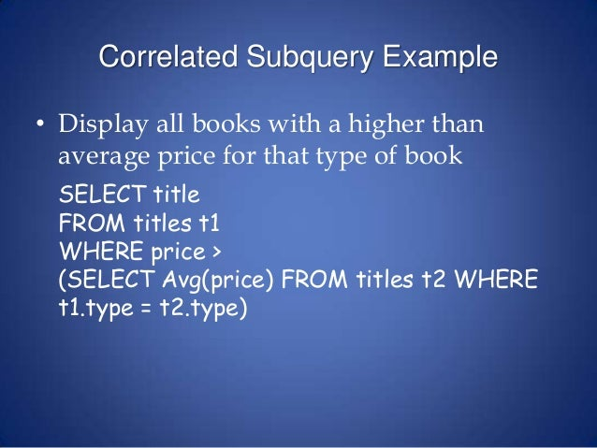
TITLES
BOOKID | TITLE | TYPE | PRICE
comic, suspense, tragedy,..

